Slide 1
Objectives
After completing this chapter you will be able,
  How to execute a SQL query using JDBC drivers?
  What is the difference between Statement and Prepared Statement?
  How to use prepared statement to fire SQL’s?

Slide 2
A Quick recap on the API’s
Java
Program
JDBC API
D
R
I
V
E
R
java.sql.DriverManager
Database
java.sql.Connection
java.sql.Statement (or)
java.sql.PreparedStatement
In this session we will discuss about the above highlighted API’s on how to use them to access the database

Slide 3
Easy steps to access database using JDBC
The steps involved in executing a JDBC query in a java program,
      Import JDBC Package & API’s.
      Loading the Driver.
      Registering the JDBC Driver.
      Establishing Connection to the Database.
      Creating a Prepared Statement (or) Statement for the DML or select query.
      Execute the statement (or) prepared statement.
      Processing the Results of a Database query.
      Closing the ResultSet and Statement.
      Closing the Connection.
Notes:
Example
“jdbc:oracle:thin:@:ipaddress:1521:databaseid”

Slide 4
Step 1 : Importing JDBC Package
Step 1: Importing JDBC Package
    The first step is to import all the relevant JDBC API’s in the application program which is going to access the database.
Example:
import java.sql.Driver;
import java.sql.DriverManager;
NOTE: Import can also be done automatically in SDE using Organize imports, as you use the appropriate API’s in the program.
Shortcut: Press CTRL+Shift+O (or) Right click, Source → Organize Imports to import the corresponding class.

Slide 5
Step 2 : Load java.sql.Driver
Step 2: Loading the Driver:
The JDBC driver used for establishing communication between the program and the database should be loaded as below.
Pre-Requisite:
Place the Oracle driver jar in class path of SDE.
  Syntax:
  Driver driver = new oracle.jdbc.driver.OracleDriver();
  (or )
  Class.forName(“oracle.jdbc.driver.OracleDriver”);
NOTE: The drivers will be provided by the appropriate database vendors like Oracle , MySQL, Informix. Example: Oracle use ojdbc14.jar

Slide 6
Step 3: Register the driver
Step 3: Registering the Driver:
  Once the Driver is loaded, it should be registered with the DriverManager.
  This is done using the static registerDriver() method of the DriverManager class.
Syntax:
DriverManager.registerDriver(driver);
// Here driver is the driver object loaded in previous slide.

Slide 7
Step 4: Establishing Connection
Step 4: Establishing Connection:
  Establish the connection with the database server using the driver manager and logon to the database providing the user credentials.
        This is done by using the getConnection() method of the DriverManager class.
Syntax:
Connection connection=DriverManager.getConnection(url,username,password);
Where,
url represents the URL of the database to be logged on.
userName, represents the user name of a database user with which we can logon.
password, represents the password of the credential.

Slide 8
Step 4: Establishing Connection (Cont)
URL Examples:
    “jdbc:oracle:thin:@[host]:[port]:SID”;
    This URL is used to make a connection to the database.
    Where,
      jdbc:oracle:thin: Represents the driver name
      host - The host name or the IP address of the machine where database server is running.
      port - The port number where database is listening for connection, default is 1521.
      SID -System ID of the Oracle server database instance.
Example: String url=“jdbc:oracle:thin:@172.16.10.05:1521:cts”
Where, CTS is the oracle instance.

Slide 9
Step 5: Creating the Statement
Step 5: Creating a statement:
  A statement object needs to be created before executing the query.
  Statement is used to execute the SQL query. This is done using the createStatement() method of the Connection Interface.
      Syntax:
      Statement stmt = conn.createStatement();
      Where,
      conn - is the connection object created in the previous slide.

Slide 10
Step 6: Executing a query
Step 6: Executing the Query
    Once a Statement object is created, the next step is to execute the query. This is done by using the executeQuery() method of the Statement interface.
    This returns a JDBC ResultSet interface.
    What is a ResultSet?
    The result set represents a row in a table, a container to hold the results of a query and access it in a java program.
Syntax:
String query=“select employee_name, salary from Employee”;
ResultSet rset = stmt.executeQuery (query);

Slide 11
Step 6: Executing a query (cont)
The example shown in the previous slide is for firing a select query. For firing DML queries like insert, update , delete use the method executeUpdate() in Statement object.
Syntax:
String query=“Insert (or) update query goes in here”
int rowCount = stmt.executeUpdate (query);
Where,
rowCount is the number of records affected by the insert or update query
IMPORTANT NOTE: PreparedStatement are used rather then Statement for firing DML and SELECT queries as they are more efficient and can execute dynamic queries (passing dynamic values).
You will learn about in in the next slides.

Slide 12
Step 7: Retrieve the data from ResultSet
Step 7: Processing the ResultSet
  Once a select query has been executed, you can do the following
    Iterate through the result set.
    Use the result set API’s to retrieve the data from the result set.
How to iterate through the result set?
Iterating through the result set is done using the next() API of the ResultSet object.
while (rs.next())
{
// Each row is iterated and data accessed.
}

Slide 13
Processing the ResultSet
How to retrieve data from result set?
  The data is retrieved using the getXYZ() methods of the JDBC ResultSet interface
  Where,
    XYZ – refers to a java data type.
    Example: getInt(), getString()
while (rs.next()) {
  String EmployeeName = rs.getString(1);
  long salary = rs.getLong(2)
  }
Here the parameters 1, 2 for the method rset.getInt(),rset.getLong() respectively denote the position of the columns in the SQL query.

Slide 14
Alternative for accessing ResultSet?
  Alternative: Instead of passing the column index you can pass the column name as parameter to the getXYZ() methods of the JDBC ResultSet interface
while (rs.next()) {
  String EmployeeName = rs.getString(“EmployeeName”);
  long salary = rs.getLong(“Salary”)
  }
Here the parameters for the method rset.getInt(),rset.getLong() are the column names mentioned in the SQL.
IMPORTANT NOTE: The recommended approach is to use column names in the getXYZ() cause if you use index and the column gets interchanged in the SQL the data access logic should be changed to reflect the new indexes.
So never use index rather use column names for data access.

Slide 15
Step 8: Closing result set
Step 8: Closing the ResultSet and Statement
  Once the data access is done the result set, statement should be closed. This is done by calls to the close() method of the ResultSet and Statement interfaces.
  Closing the ResultSet and Statement frees the corresponding user process and memory allocated in the database.
Syntax:
rs.close(); // Result set being closed
stmt.close(); // Statement being closed

Slide 16
Step 9: Closing connection
Step 9: Closing the Connection
  The last step is to close the database connection opened in Step 4.
  This is done by a call to the close() method of the Connection interface.
        Syntax:
        conn.close();// Connection to be closed
IMPORTANT NOTE: Always close connections after query(ies) execution. Failure in closing connections will result in database server running out of connection and thus application will not be able to connect to database, resulting in application crash. Always close connections in finally blocks.
So always close connections after query(ies) execution in finally block.

Slide 17
JDBC Access in a Nutshell
The steps to execute a JDBC query is listed below.
Step 1: Importing JDBC Packages
  import java.sql.Driver;
  import java.sql.DriverManager;
Step 2: Loading the Driver
  Driver driver=new com.mysql.jdbc.driver.Driver();
Step 3: Register the Driver
  DriverManager.registerDriver(driver);
Step 4: Establishing Connection
  Connection connection=DriverManager.getConnection(url,username,passwd);
Step 5: Creating A Statement
  Statement statement=connection.createStatement();

Slide 18
JDBC Access in a Nutshell (Cont)
Step 6: Querying the Database
  String query=“select ename, esal from emp”;
  ResultSet rset = stmt.executeQuery(query);
Step 7: Processing the Results of the Query
  while (rset.next()) {
    int name= rset.getInt(1);
    long sal=rset.getLong(2)
  }
Step 8: Closing the ResultSet and Statement
  rset.close();
  stmt.close();
Step 9: Closing the Connection
  conn.close();

Slide 19
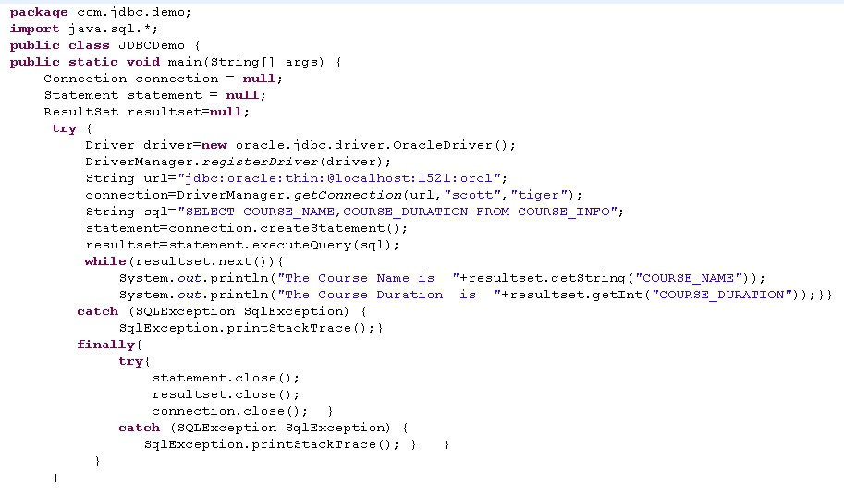
A Code Example
All the required JDBC API’s are imported.
Step 2 & 3: Load and register driver.
Step 4 : Establish the database connection.
Step 5 : Create a statement.
Step 7: Iterate through the result set and display it.
Step 6: Execute the statement.
Step 8 & 9: Close the statement, connection in finally block.

Slide 20
Lend A Hand-Using JDBC Statement
Given a table named Student_Info_<Employee Id> with columns namely student_id,First_name.
Develop a java class named “NameSortDemo” with a main method which will connect to the database and display all the names in Alphabetical Order.
Step 1: Insert the below records into the table
Step 2: Develop a method connectDataBase() in NameSortDemo which contains the code for establishing the connection with the database.
Step 3: Develop a method sortStudents() in NameSortDemo to fire select query to retrieve student data ordered by student name and print the student details in the console as follows. “Student Id is”+<Student id>” First Name is” <First Name>
Student_ID | First_Name
56 | Xavier
54 | Bino
12 | Arjun

Slide 21
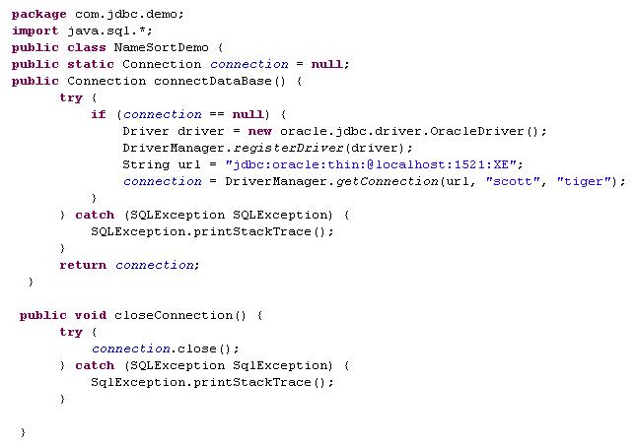
Lend A Hand-Solution Using JDBC Statement
Loading and registering the Driver and establishing Connection
Method for closing The Connection

Slide 22
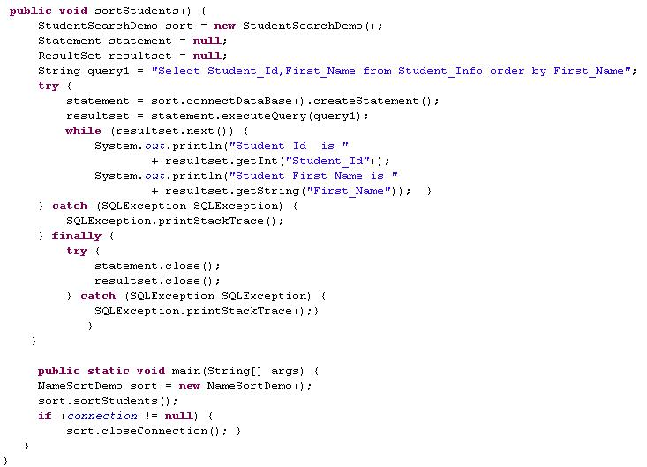
Lend A Hand-Solution Using JDBC Statement
Executing the query and storing it in the resultset and traversing through the resultset
Closing theStatement and ResultSet

Slide 23
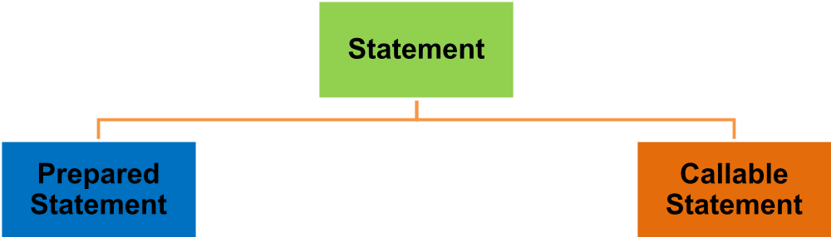
Statements in JDBC
We have two other flavors of statements
Prepare Statement are precompiled query used for executing a same query N number of times in application program by changing the values in the query. This is more efficient than normal Statements.
Callable Statement are used for executing procedures and functions residing in database server.

Slide 24
Java.sql.PreparedStatement
PreparedStatement Interface:
  java.sql.PreparedStatement interface extends java.sql.Statement interface.
  Prepared Statements are precompiled Statement.
  Using PreparedStatement can fire a same SQL N number of times with multiple values.
  Since prepared statement are precompiled they execute faster than Statements which gets compiled every time.
Example:
String query = “insert into Employee values (?,?,?)”;
PreparedStatement prepareStatement = connection.prepareStatement(query);
Lets analyze the syntax in a few moment.

Slide 25
PreparedStatement Syntax
Let us analyze a prepared statement now.
Example:
String query = “insert into Employee values (?,?,?)”;
PreparedStatement prepareStatement = connection.prepareStatement(query);
Let us analyze a prepared statement now:
The “?” In the query refers to the IN parameter
The IN parameter is a parameter whose value is not specified when the SQL statement in created.
A value for each IN parameter should be set in the Java program before executing the prepared statement.
So the same prepared statement can be executed N number of time with multiple values.

Slide 26

How prepared statement works?
Database
Executes Query
Select * from employee
Step 1: Database engine will pre- compile the query.
Step 2: Database engine will execute the query.
Response Sent to client.
Application Program
Using statement to execute query: Now if the same query (Select * from employee) is executed again the database engine will perform steps 1 & 2 for the query execution.
Using prepared statement to execute query: Now if the same query (Select * from employee) is executed again the database engine will perform only step 2. So the query is precompiled once.
Inference: Precompilation is a costly process and takes more time. Since prepared statement compiles the code only once and reuses it for subsequent execution it is faster than normal statements which pre-compiles query every time.
NOTE: In prepared statements if the query is changed say “Select * from employee where id=101” the precompilation happens again.

Slide 27
Statement vs PreparedStatement
Statement | PreparedStatement
A Statement is used for executing simple SQL queries . | A Statement is used for executing dynamic SQL queries with values being changed during run time.
When Statement is executed, the SQL query is passed to the database, where it has to be parsed and compiled before it can be executed. | PreparedStatement send the sql query to the database, pre-compile it and saved in a cache. For subsequent query execution the same precompiled query will be used.
Statement execution is slow. | PreparedStatement execution is fast.

Slide 28
Steps to execute PreparedStatement
Register the driver and create DB connection.
Create Prepared statement object.
Bind variables for IN parameters.
Execute the Prepared statement.
Create the prepared statement for the query
Example:
// Load driver and create connection
String query = “insert into Employee values (?,?,?)”;
PreparedStatement prepareStatement = connection.prepareStatement(query);
prepareStatement.setInt(1, 75);
prepareStatement.setString(2,”John”);
prepareStatement.setInt(3,2500);
int iUpdatedRecords = prepareStatement
.executeUpdate();
The IN parameters are set for each “?”. The order in the query should match the index number when binding the values.
This executes the query and returns the number of rows that have been inserted/updated in the table

Slide 29
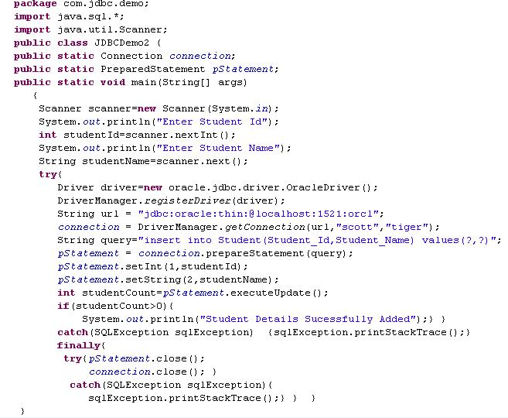
PreparedStatement Example
Load and register driver.
Establish connection
Set Parameter values
Create a prepared statement using the given SQL
Close the statement, connection in finally block.
Execute query

Slide 30

Time To Reflect
Associates to reflect the following before proceeding.
What are the two ways of loading drivers ?
Usage of PreparedStatement increases the performance Why ?
What is the use of Result Set?
What API I use for executing stored procedures?

Slide 31
Lend A Hand-Using JDBC Prepared Statement
Given the table named Student_Info_<Employee_Id> with columns namely student_id,First_name.
Develop a java class named “StudentSearchDemo” with a main method which will connect to the database insert the below records and display all the names whose student id <50.
Step 1: Develop a method connectDataBase() in StudentSearchDemo which contains the code for establishing the connection with the database..
Step 2: Develop a method storeStudents() in StudentSearchDemo which has the insert queries to load the above mentioned data using prepared statement.
Step 3: Develop a method retrieveStudents() in StudentSearchDemo to fire select query using prepared statement to retrieve student id < 50. The following message should be displayed “Student Id is”+<Student id>” Student First Name is” <First Name>.
Step 4: Execute the storeStudents() and retrieveStudents() method from the main method.
Student_ID | First_Name
34 | Rajesh
47 | Vimal
98 | Arun

Slide 32
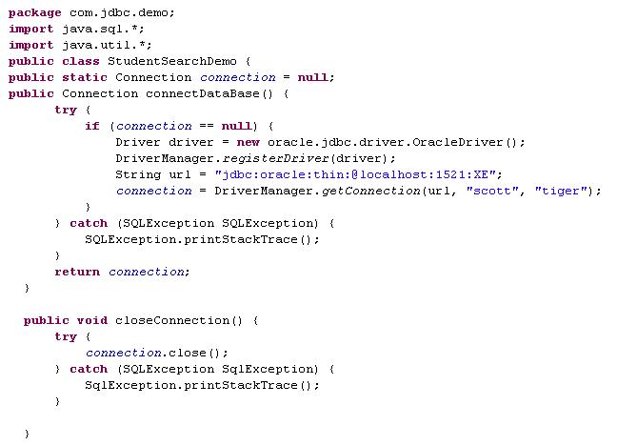
Lend A Hand-Solution Prepared statement.
Loading and registering the Driver and establishing Connection
Closing The Connection

Slide 33
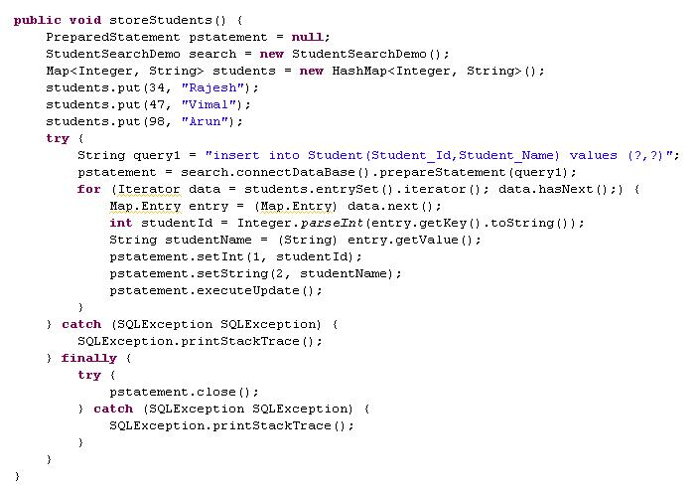
Lend A Hand-Solution Prepared statement.
Loading the data to be inserted into the table in a HashMap
Getting the data from the HashMap and setting the values as parameters

Slide 34
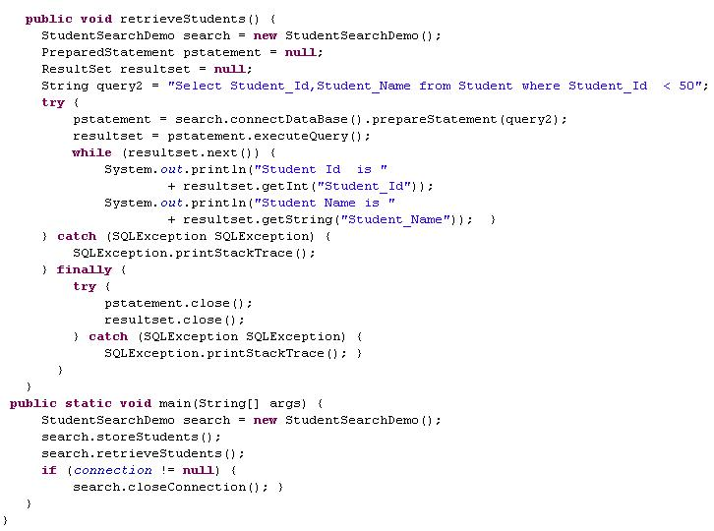
Lend A Hand-Solution Prepared statement.
Executing the Query
Traversing through the resultset and displaying the output
Closing the PreparedStatement and Connection

Slide 35
Lend A Hand-Executing JOINS
Prerequisites:
    Create a table student_marks as shown below and load the test data as mentioned below.
Student_Info_<Employee_Id>
Student_Marks_<Employee_Id>
Student_Id | Student_Name
1001 | Karan
1564 | Vimal
1787 | John
2787 | Jai
Student_Id | Eng_Mark | Maths_Mark | Science_Mark
1787 | 67 | 43 | 90
1001 | 67 | 98 | 89
2787 | 12 | 78 | 66
1564 | 56 | 78 | 87

Slide 36
Lend A Hand-Executing JOINS
Problem Statement: Develop a program “StudentMarksDemo” which will retrieve the following data for all the students who has marks. Student id, name , marks of math's, science and English.
Step 1: Develop a method connectDataBase() in StudentMarksDemo which contains the code for establishing the connection with the database.
Step 2: Develop a method getStudentMarkDetails() in StudentMarksDemo to fire select query using prepared statement to retrieve the columns from both Student_Info table and Students_Marks.
Step 3: Invoke the getStudentMarkDetails() method from the main method.

Slide 37
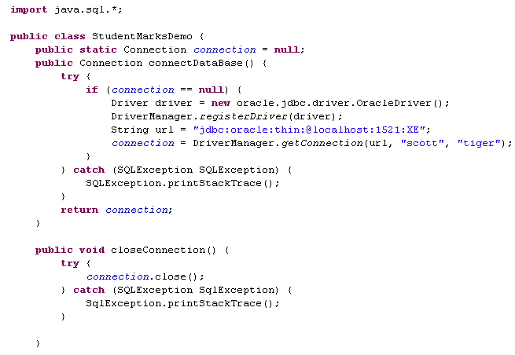
Lend A Hand-Solution Executing JOINS.

Slide 38
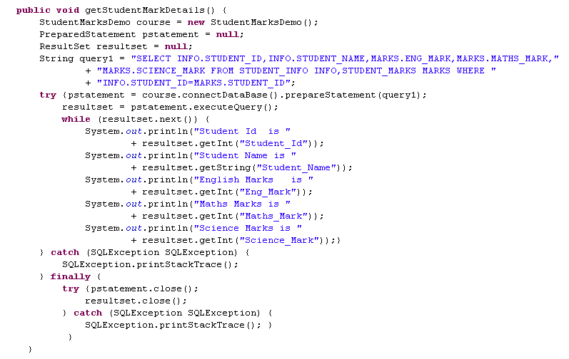
Lend A Hand-Solution Executing JOINS.

Slide 39
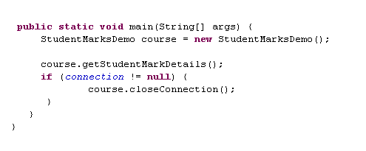
Lend A Hand-Solution Executing JOINS.

